Slide 1

Samuel Bailey
Assignment 3-2

Slide 2
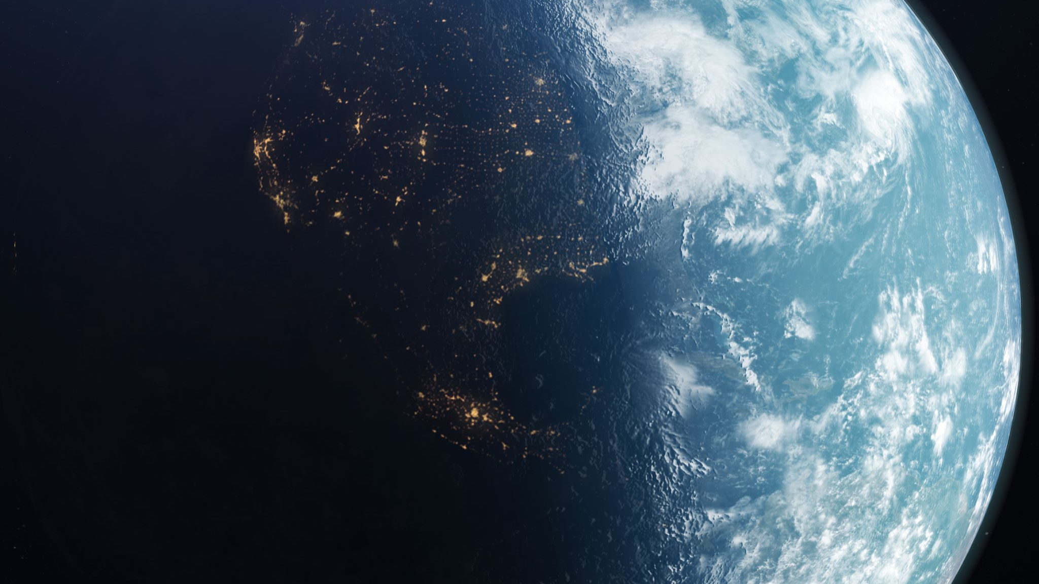

How we became clean
Before the 1930’s there wasn’t anybody taking out the trash or cleaning water throughout the world.

Slide 3
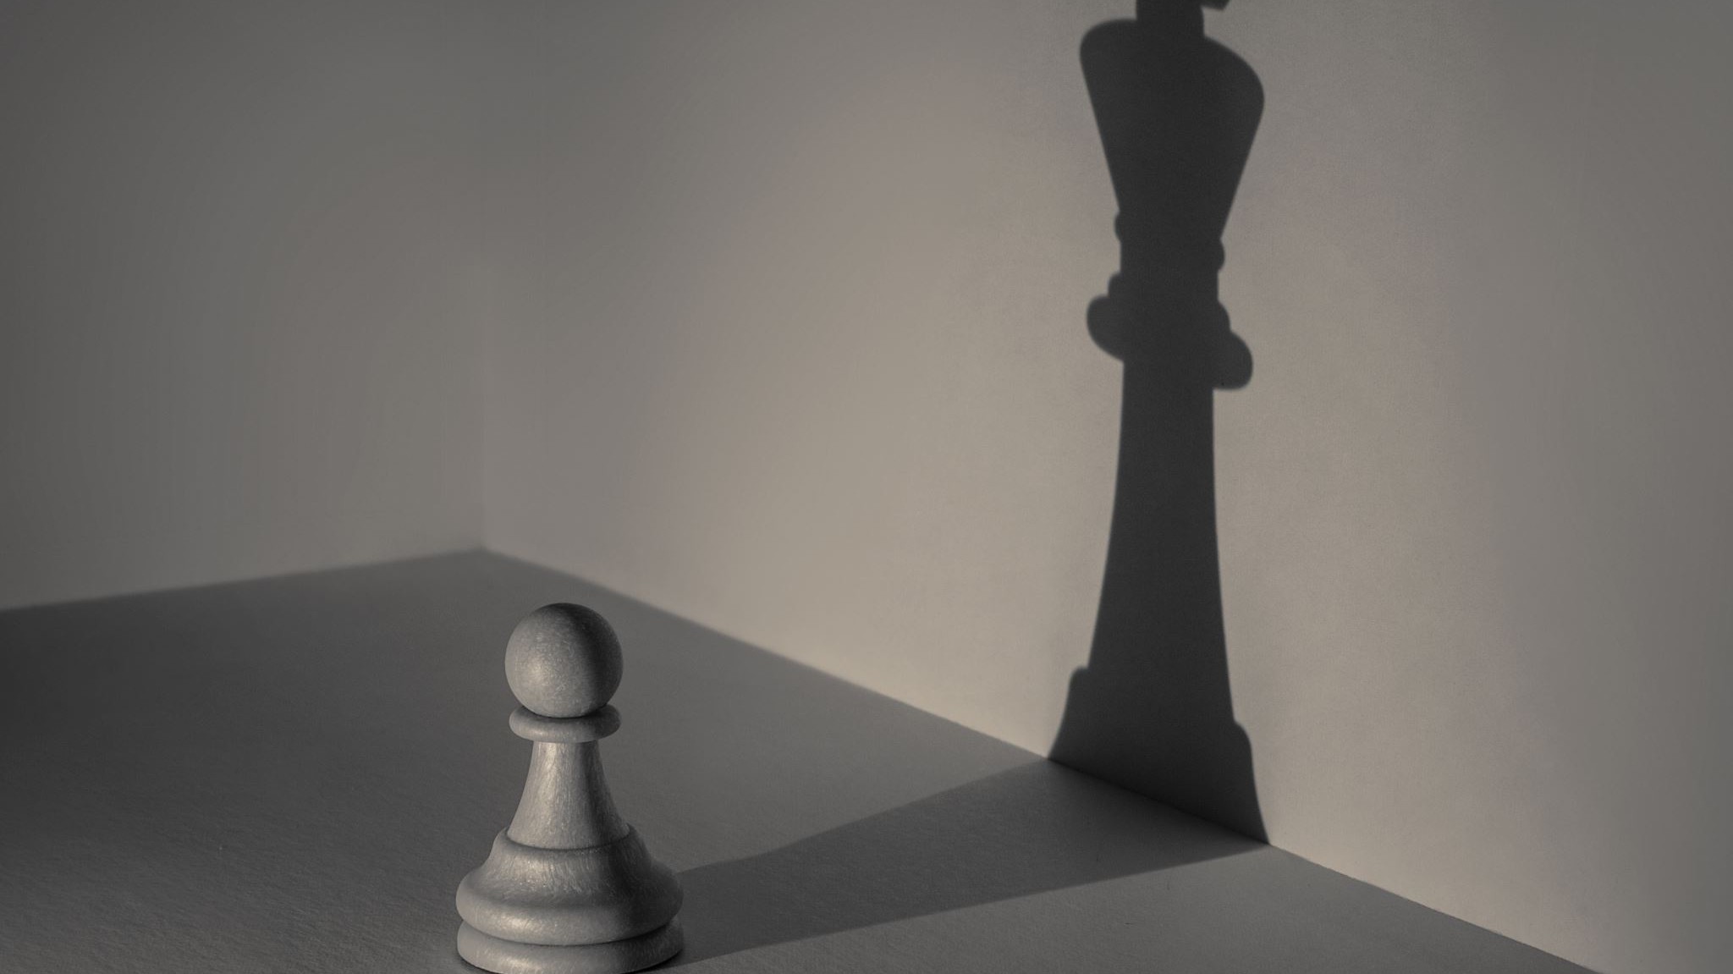
What we did wrong
Thinking we saved ourselves from filth we ended up hurting ourselves from a lack of knowledge about water.

Slide 4
Citations
Clean: How We Got to Now with Steven Johnson. Produced by PBS, Films Media Group, 2014. Films On Demand, fod.infobase.com/PortalPlaylists.aspx?wID=105049&xtid=60741. Accessed 12 July 2021.

